Slide 1
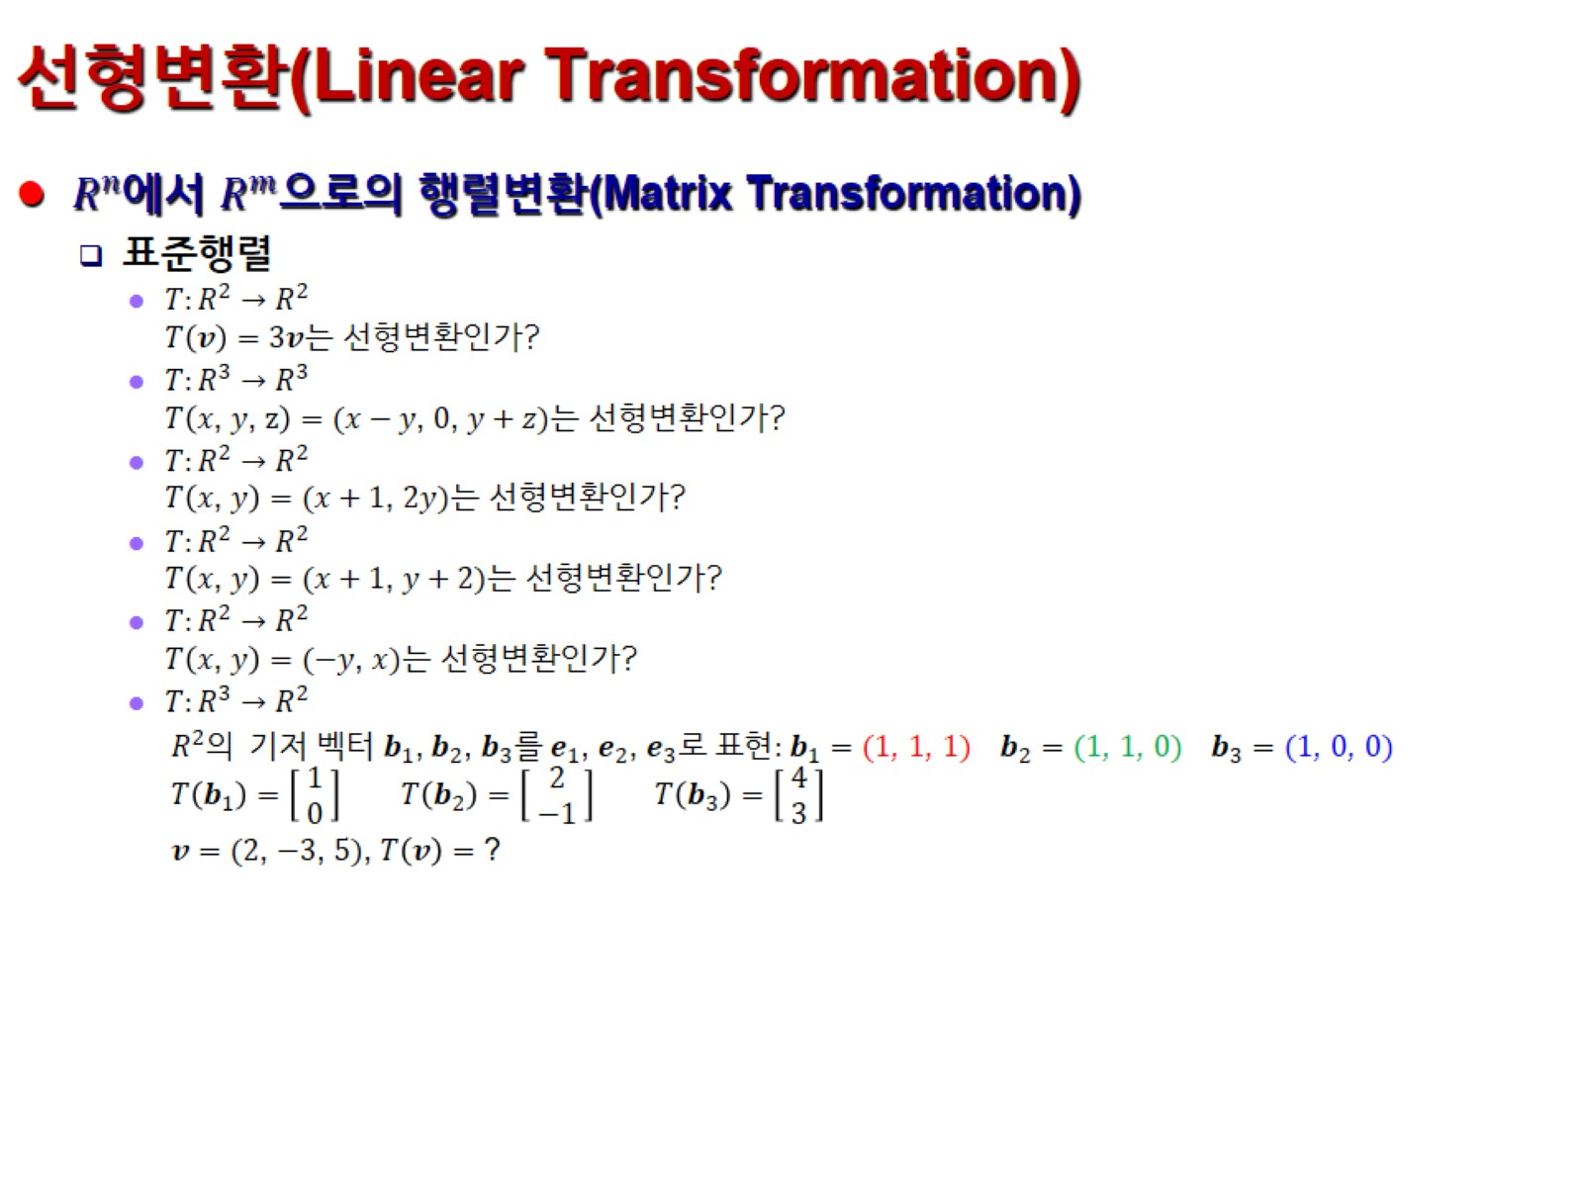
선형변환(Linear Transformation)

